Slide 1
Project Title: Cost savings from W/9T CCU restoration
Charter Template
Business Case/objectives:
There are several cases of CCU theft incident at Okoloma axis of IMOR/OKGP PU recently.
This poses a lot of concern as the Asset team security cannot assure the security of the new CCUs of wells if replaced by CWI Team.
Afam W/9T CCU was then reportedly stolen by unknown persons on 15 JUL 2018 and CWI plans to replace the CCU in order to meet up with current DOMGAS demand. Associated deferment before well restoration for 22 days (CCU replacement) : 123.2 mmscf and 12,870bbls
This project aims at strengthening the CCU security by application of welding and wall concreting the CCU on the ground surface making theft impossible and sustaining the well production 5.6 mmscf of gas and 585bbls of condensate for the rest of the year .
Other well CCUs to secure are Afam W/23T, 8T & Obeakpu 7T(Securing a total production of 79.9mmsf and 16,165 bbls
Potential Benefits & Measurement:
Cost savings of replacing 1 pcs of CCU is USD 40,000
Cost of mobilization for CCU installation by CWI is USD2,500
Critical Success Factors:
High-level Timeline:
L0-L1: 22 July 2018
L2: 24 July 2018
L3: 30 July 2018
L4: 31 August 2018
L5: 20 September 2018
Initiative End
Project Scope/Actions :
Service old CCUs
Weld the CCU on a strong metallic stand with bold stand
Cast CCU with concrete on the ground surface
Team members:
Onoh Ebere
Kennedy Ehighalua
Solomon Olofuru
George Onweni

Slide 2
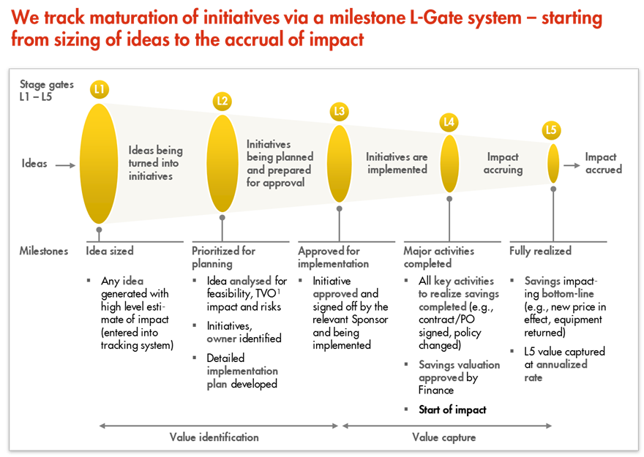
L1 – L5 Gates

